Slide 1

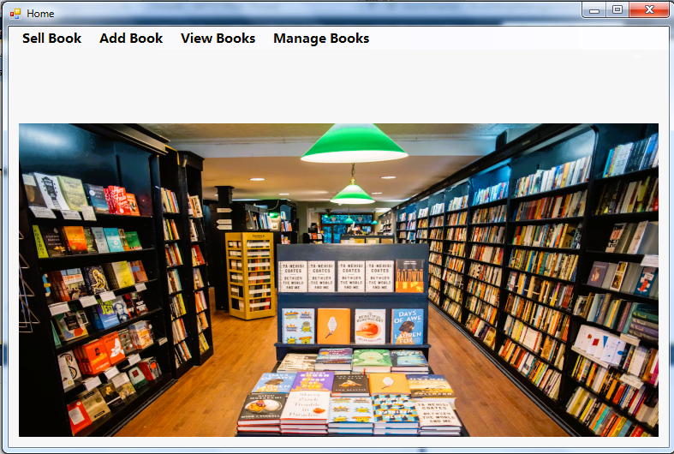
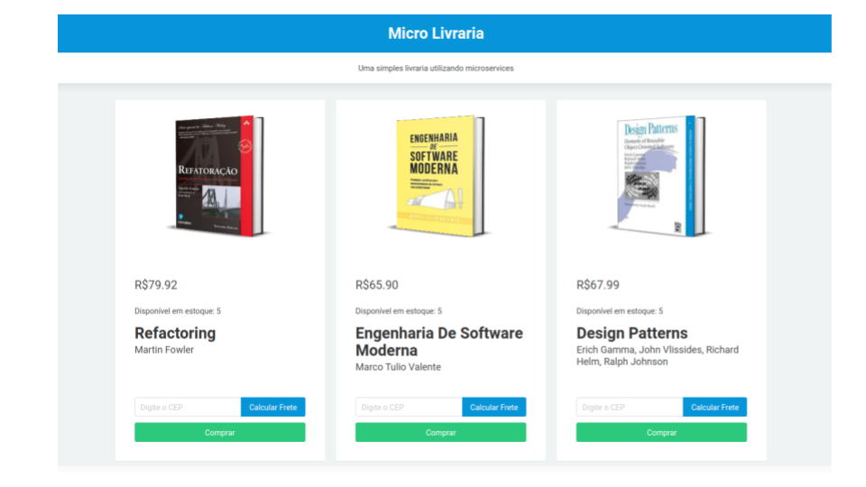
Data Structure Project Presentation
Title
Online Book Shop Management
Data Structure Project Group-F

Slide 2



Presented to our Course Teacher
Name : Mr. Rahmatul Kabir Rasel Sarker Designation : Lecturer
Institute : Daffodil International University

Slide 3






Presented By
Hossain Ibn Masudul Haque (232-15-260)
Farhan Shahid
(232-15-474)
Nasim Sheikh
(232-15-550)
Hossain Ibn Masudul Haque
Nasim Sheikh
Farhan Shahid

Slide 4



Introduction
Imagine a place where you can discover and buy books, right at your fingertips. Today, we are going to share a project we have been working on. In the next 10 minutes or so, we'll figure out why an online bookshop is important and its use in the modern world. Before we start, I want to express my gratitude to our course teacher, who helped us on this journey.
Taking the surge of digitalization into consideration, it was expected that nearly everything we need would be available online within a short time. Books were no exception. Carrying on the legacy of online shopping, books of a variety of kinds are now for sale online in Bangladesh.
Here are 6 examples of online shops you can order books pretty easily.
1. Rokomari.com
2. Daraz.com.bd
3. Bookshopbd.com
4. Papertree.com.bd
5. Branoo.com
6. Backpack

Slide 5



OBJECTIVES
The objectives of our online bookshop management program are given below
To efficiently and effectively manage the various aspects of running an online bookstore.
Maintain a large book selection, and fast delivery.
Managing inventory efficiently.
4. Keeping costs under control
Using data from users to improve ourselves.
Help students and researchers because it will be time and cost friendly.
Overall, our aim is to make this program a democratize access of information and promote a culture of reading.

Slide 6



Motivation
Today, I'm excited to share the motivation behind our online bookshop project. It's not just about selling books; it's about
Creating a digital space.
Connecting readers with stories.
Creating a community of book lovers.
Making literature easy to access.
Why do we need an online bookshop?
User don’t know whether the shop is open or not.
User don’t know whether the book is available or not.
Less physical labor cost.
Less time and energy.
Together, we're not just building websites; we're creating a special place where stories unfold, and readers connect. Let's dive into the joy of books and share it far and wide!

Slide 7



Tools
Physics (Book Name)
PHY
(Book ID)
*
Data Structure
DS
*
Biology
Bio
*
Maths
Mat
NULL
Dynamically allocate the memory of the entire stall and can decide what the space of the stall will be according to our number of books
We implemented the project using:
Dynamic Memory Allocation
Linked list
Using Linked List in this project we can,
Insert a book
Delete a book (delete in the beginning, middle and end)
Display the present linked list
Search from the linked list
Traverse the linked list
These interconnected nodes, each representing a book, allow seamless updates and additions without reformation of the entire database. Unlike traditional arrays, linked lists optimize memory usage, enabling us to scale our inventory effortlessly

Slide 8

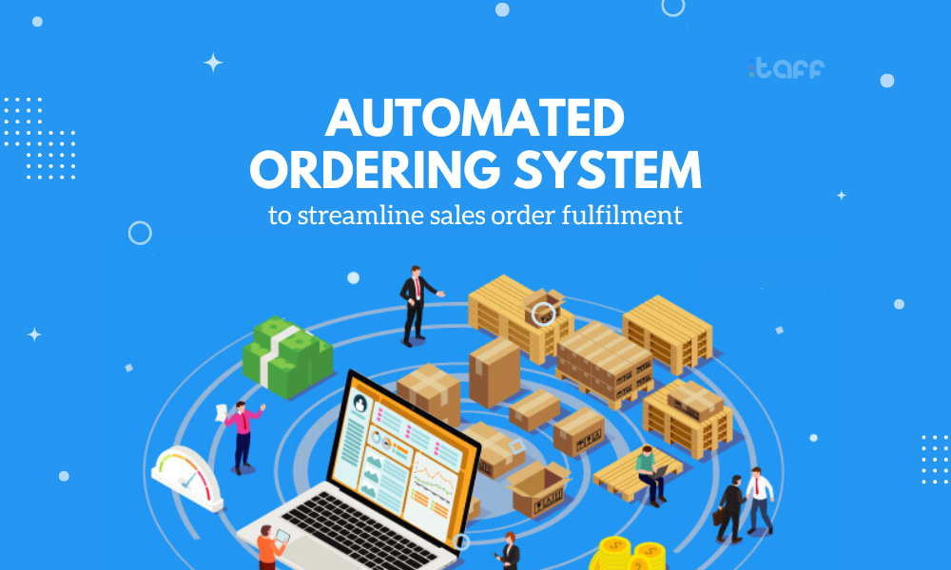
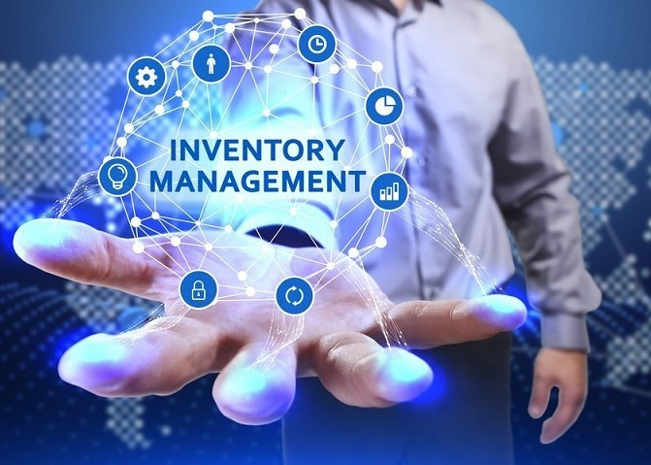


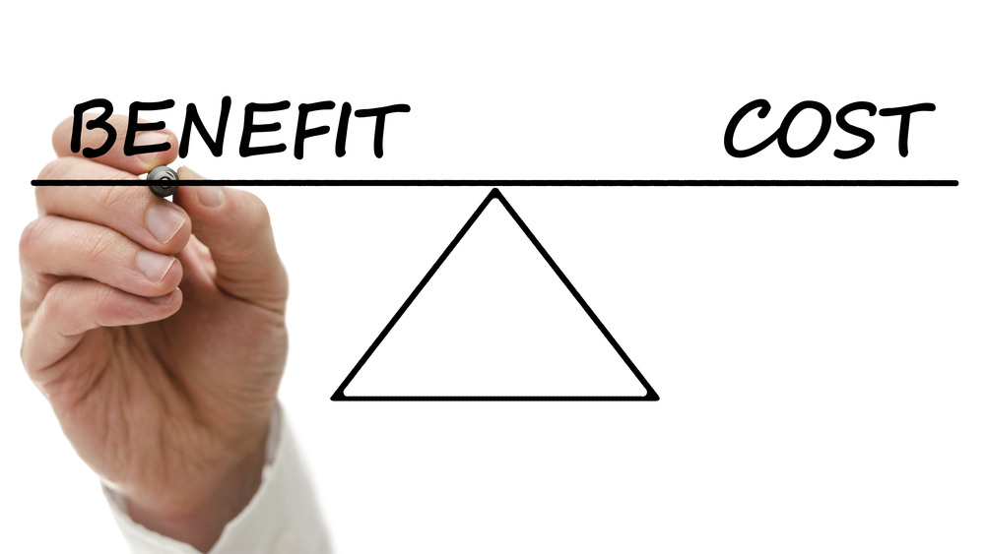

Expected Outcomes
Order Processing Automation
Efficient Inventory Management
User-Friendly Interface
Order Cancelling Automation
Cost-Effectiveness

Slide 9




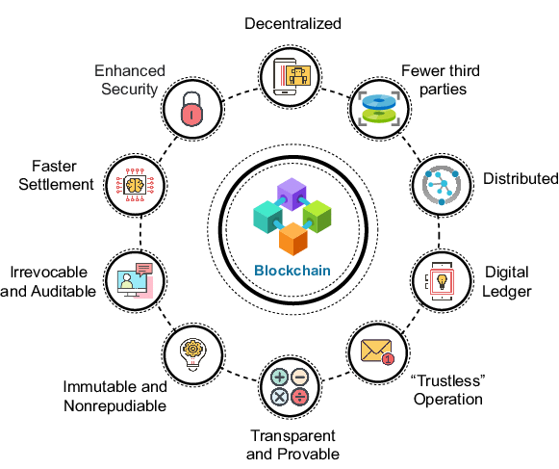

Future Work
Right now as a beginner we are implementing this project as a code but in future we desire to implement this project as in a website or adroid/ios app.
Voice Search and Virtual Assistants
Advanced personalization
Blockchain for Enhanced Security

Slide 10


